Slide 1

Machine learning Techniques(PMTAI504) Name of the Candidate : Manasi Prakash Renuse
_________________________________________________________________________
NAME OF THE GUIDE: Dr. Sagar Pande Sir
DEPARTMENT OF CSE( AI ) MTech
PCET’s Pimpri Chinchwad University
Established under Govt. of Maharashtra Act No. V of 2023
Gut No. 44, 46, 48, 49 and 50, Sate, Maval (PMRDA) Dist. Pune-412106 Maharashtra, India

Slide 2

Naïve Bayes Classifier & Gaussian Naive Bayes
.

Slide 3
Naïve Bayes Classifier
The Naive Bayes Classifier is a foundational machine learning algorithm rooted in probabilistic modeling and Bayes' Theorem. The discrete data version is perfectly suited for classification problems where all input features are categorical (like 'Sunny', 'Yes', 'Medium’).
The goal is to calculate the probability of a data point belonging to a certain class,given its features ,and then choose the class with the highest probability.
We are trying to find out Posterior Probability P(Class|Features).

Slide 4
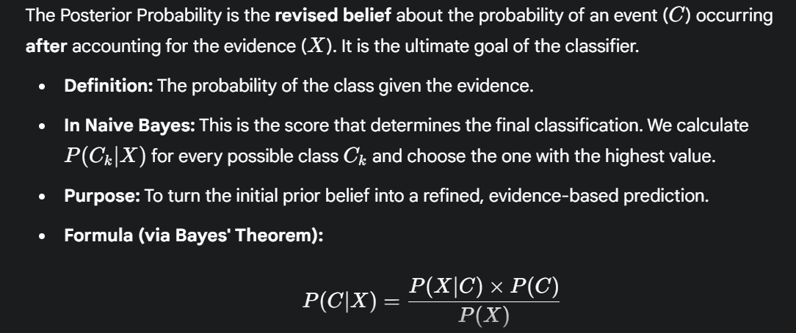
Posterior Probability

Slide 5
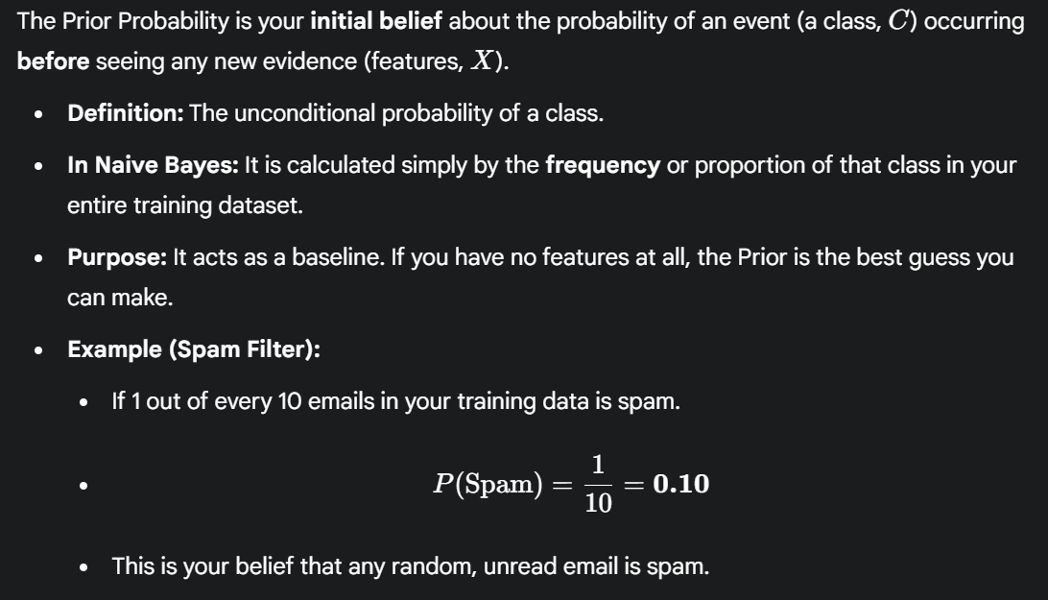
Prior Probability

Slide 6
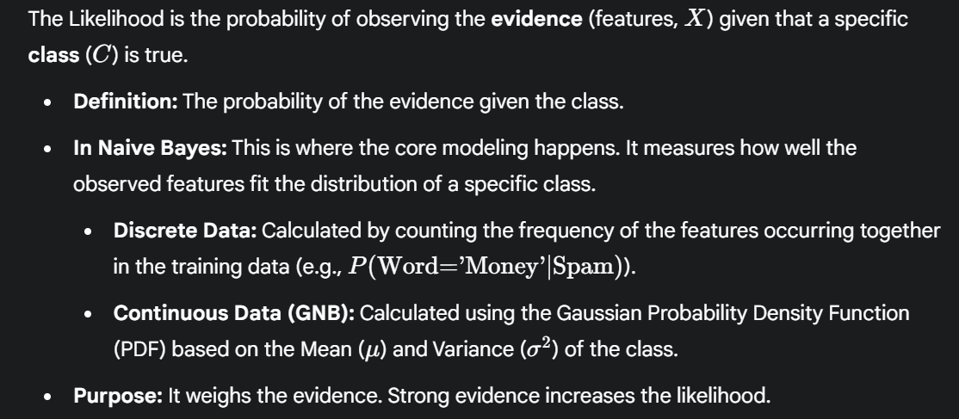
Likelihood

Slide 7
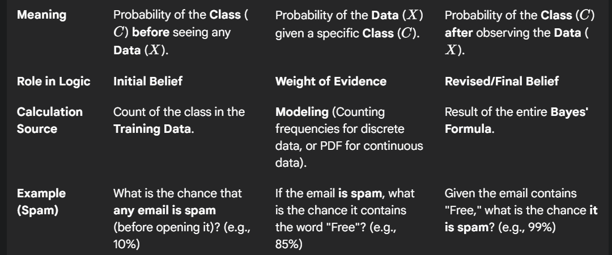
Concepts

Slide 8
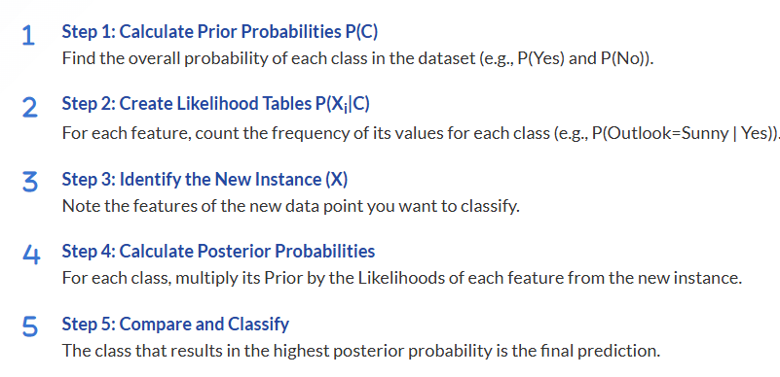
Steps to solve Naïve Bayes Classifier

Slide 9
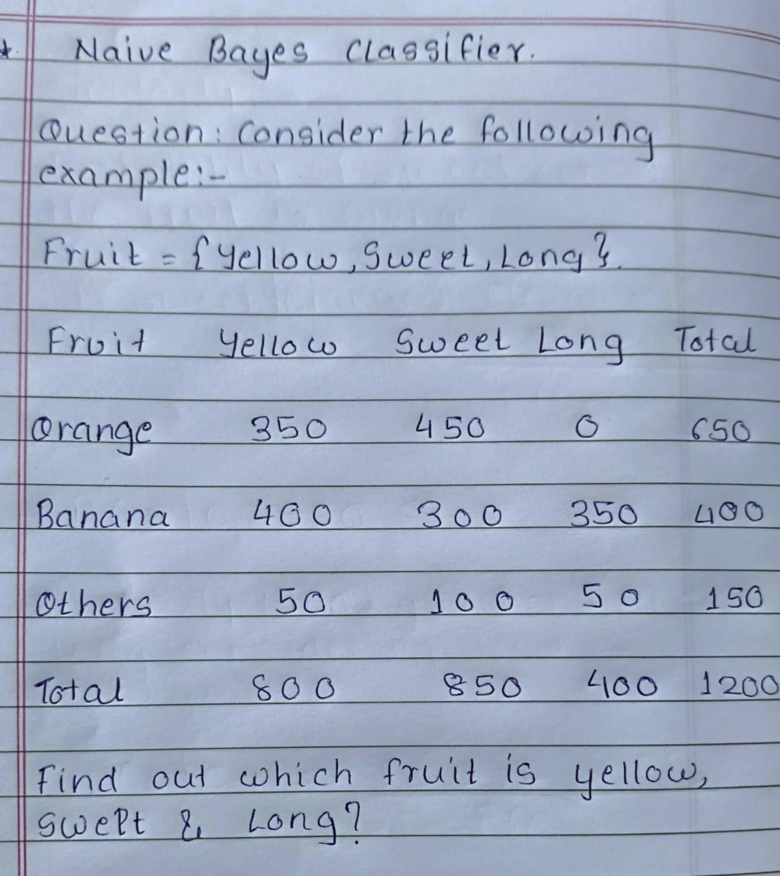
Numerical

Slide 10
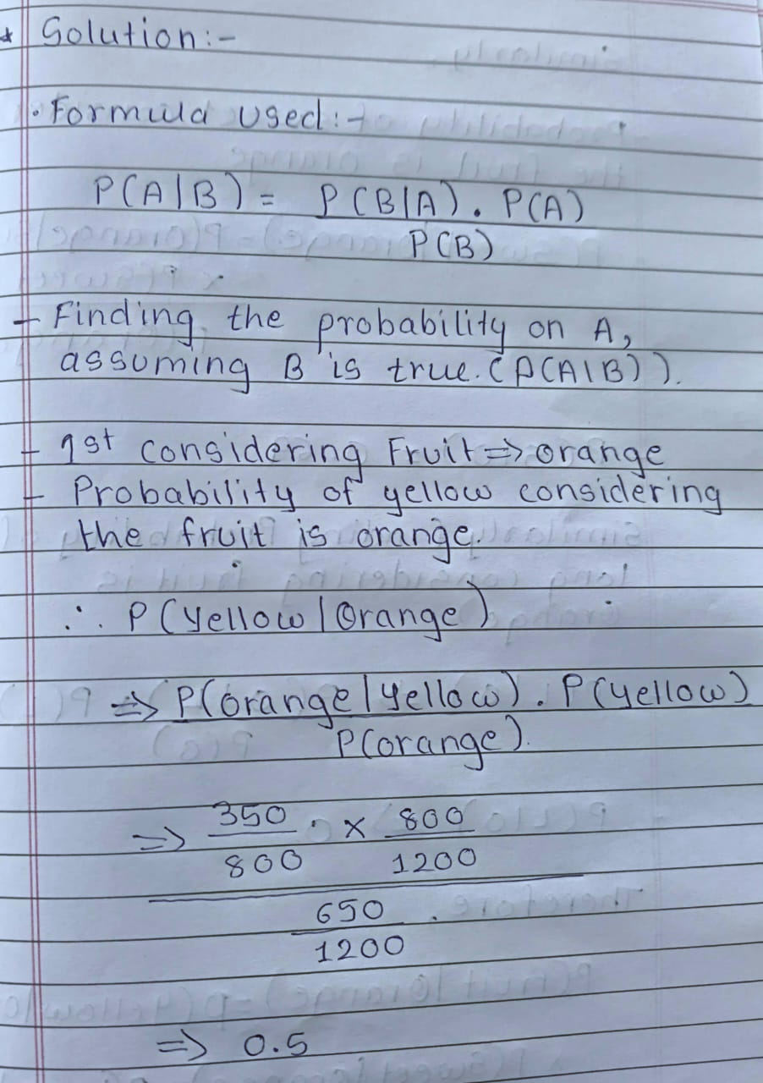
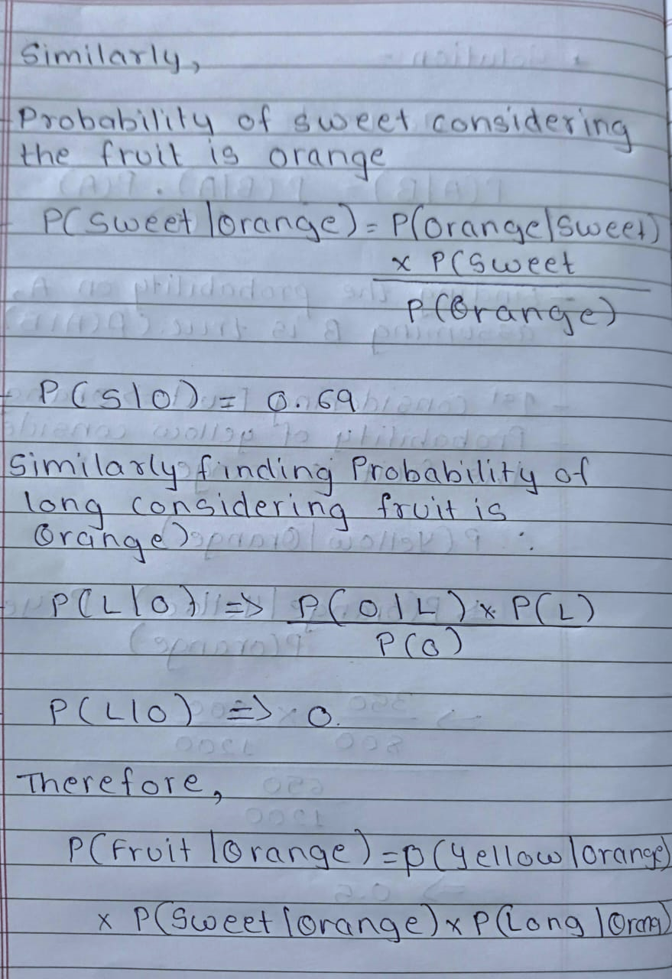
Soln:-

Slide 11
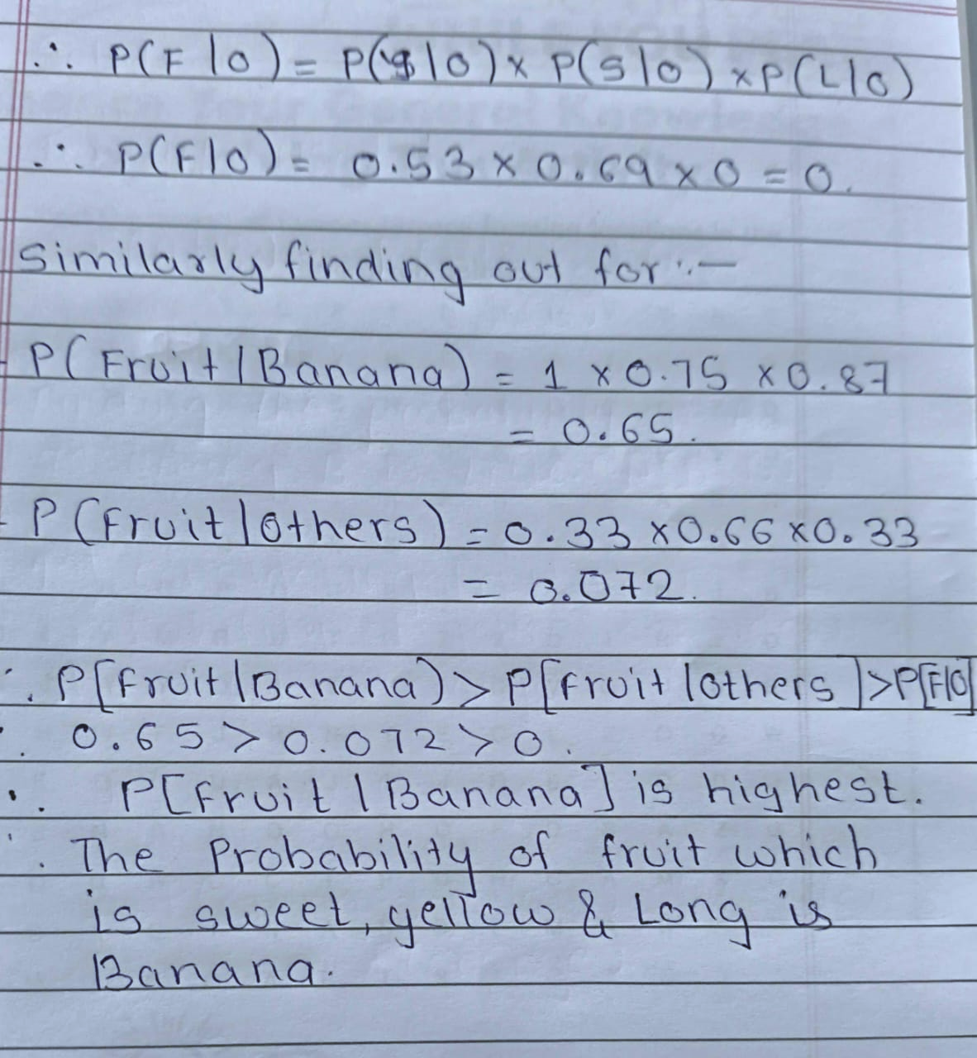
Soln:-

Slide 12
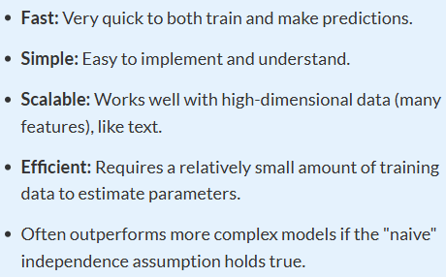
Advantages

Slide 13
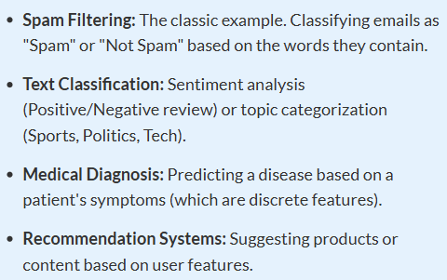
Real World Applications

Slide 14
Gaussian Naive Bayes
The Gaussian Naive Bayes (GNB) classifier is a fundamental machine learning algorithm specifically designed for classification problems where the input features are continuous (real-valued) and are assumed to follow a Normal (Gaussian) distribution.
It is one of the most widely used variants of the Naive Bayes family.
In the standard discrete Naïve Bayes it is impossible to calculate the probability og specific continuous numbers (like 98.67).
Since there are infinite possibilities for a continuous variable, the probability of any single exact value is zeo
Gaussian Naive Bayes solves this by switching from calculating discrete probabilities to calculating probability densities using the Gaussian distribution

Slide 15
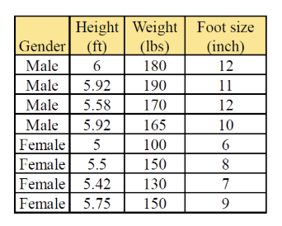
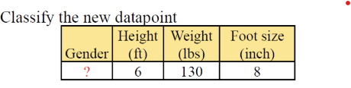
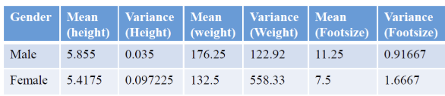
Numerical

Slide 16
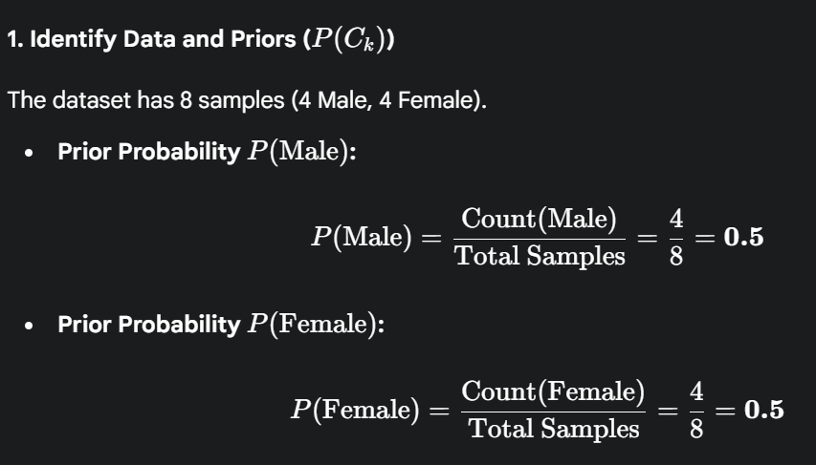
Soln:-

Slide 17
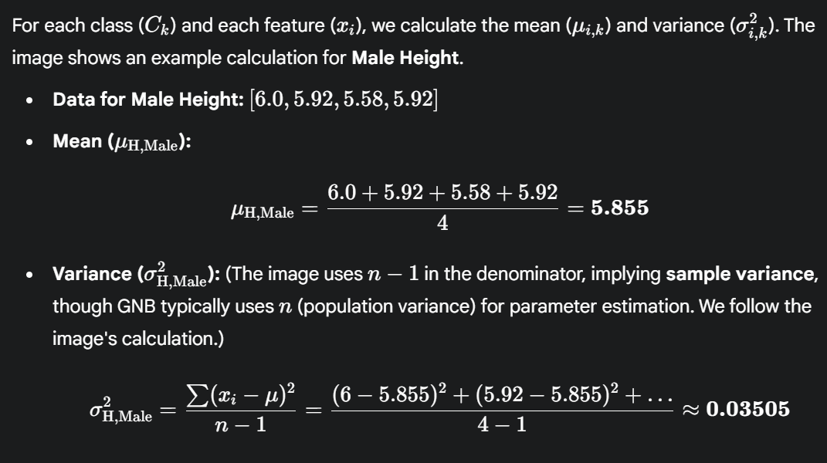
Soln:- 2.Calculate mean and variance

Slide 18
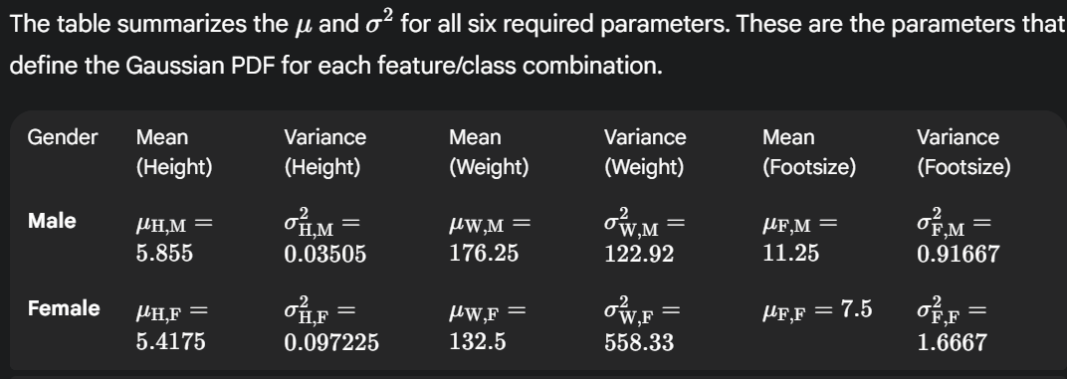
Soln:- 3.Training result

Slide 19
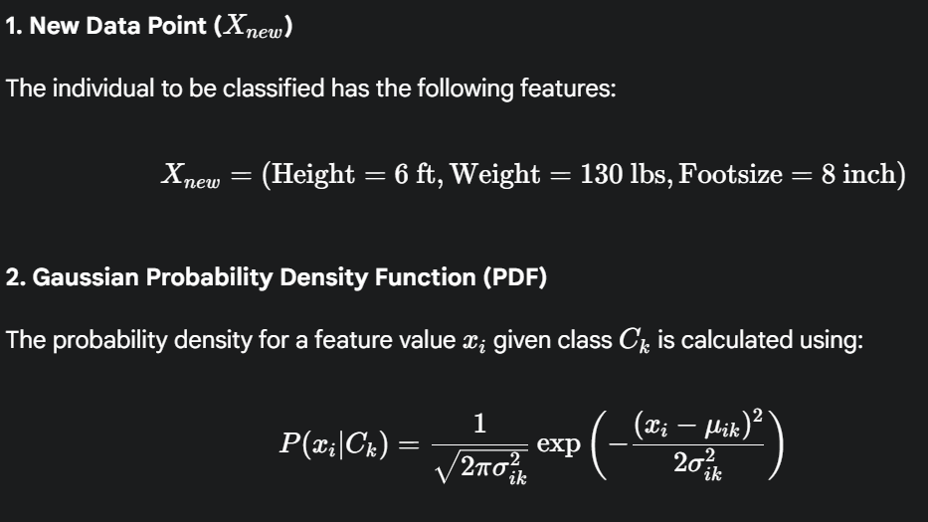
Soln:-Prediction Phase (Classifying the New Data Point)

Slide 20
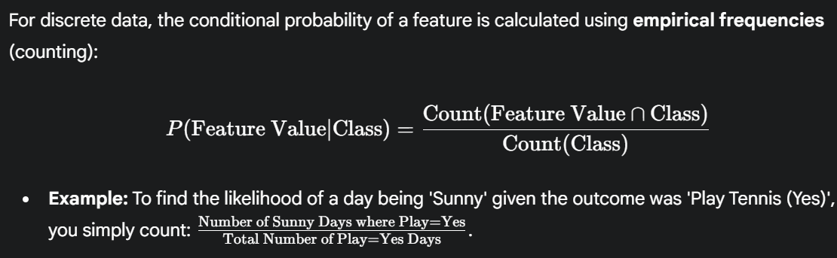
Soln:-

Slide 21
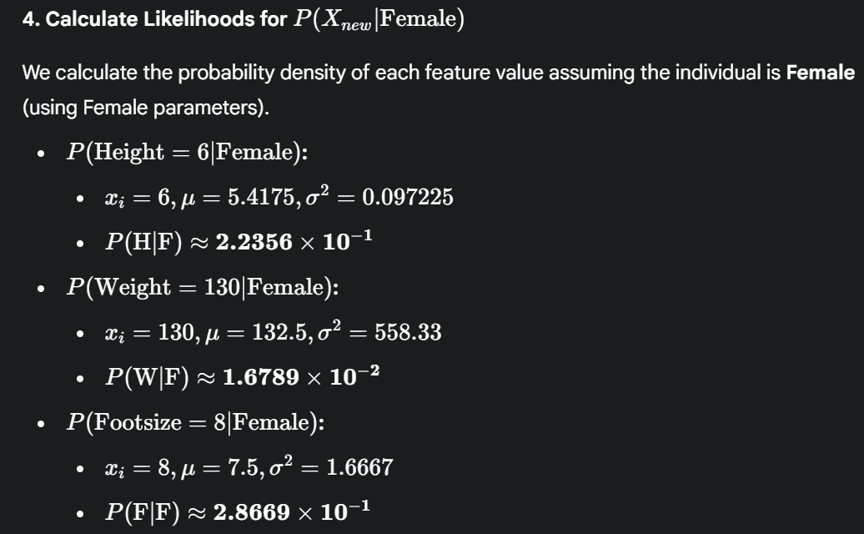
Soln:-

Slide 22
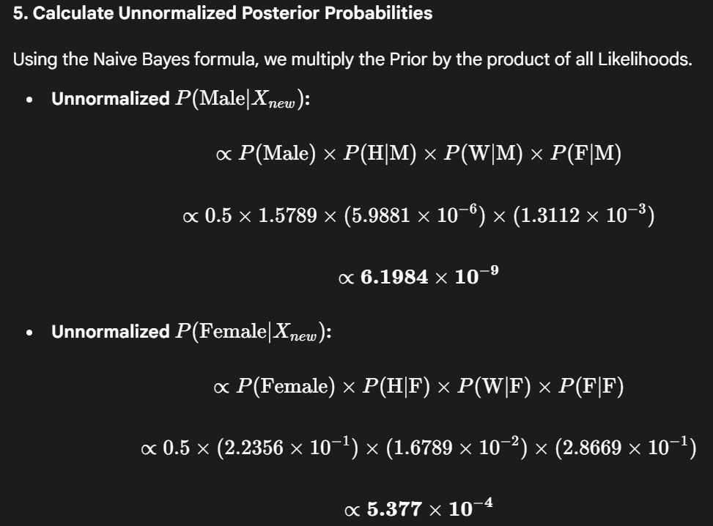
Soln:-

Slide 23
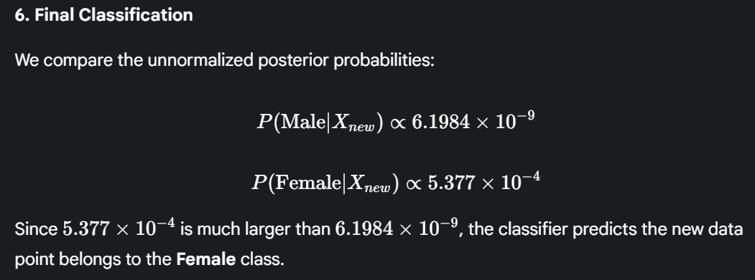
Soln:-

Slide 24
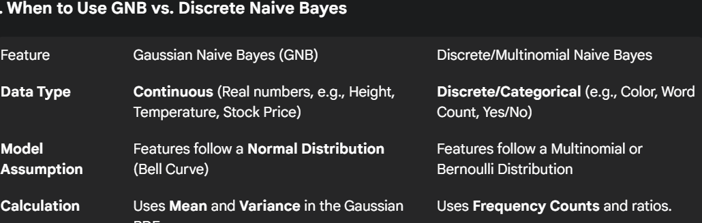
Guassian v/s Discrete Naïve Bayes

